Slide 1


Windows 10 Deployment With MDT
JITESH KUMAR, SCCM | MEMCM

Slide 2

Session Objective
Review the Windows 10 Image Capturing Process
Gather requirements
Create MDT Task Sequences
Configure the Deployment Share
Offline MDT Deployment Media
Troubleshooting Tips

Slide 3
Preparation
Infrastructure
Microsoft Deployment Toolkit (MDT)
Configuration

Slide 4
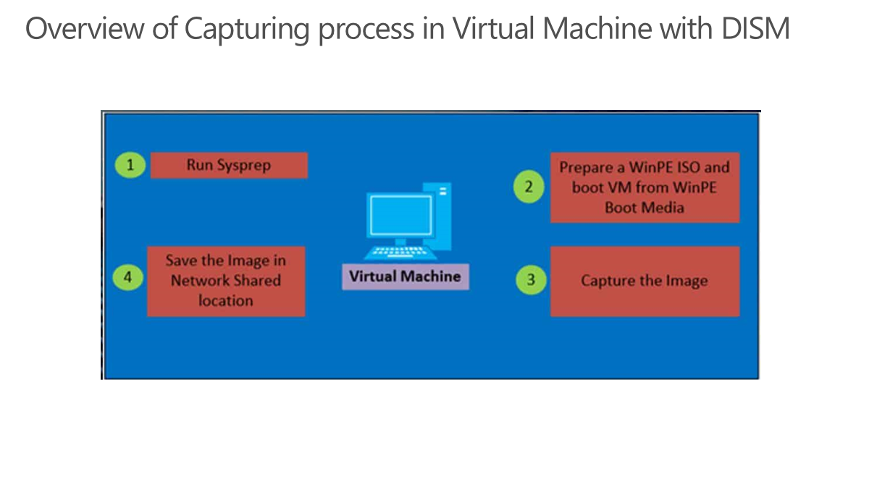

Slide 5
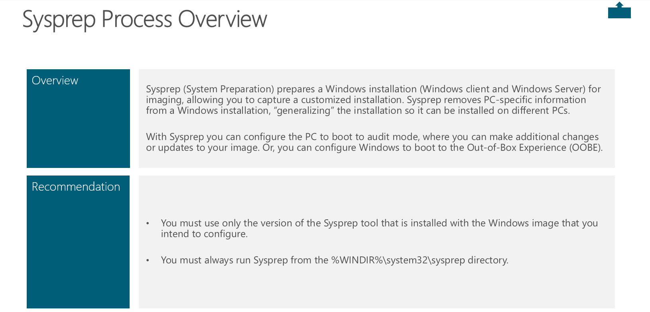

Slide 6
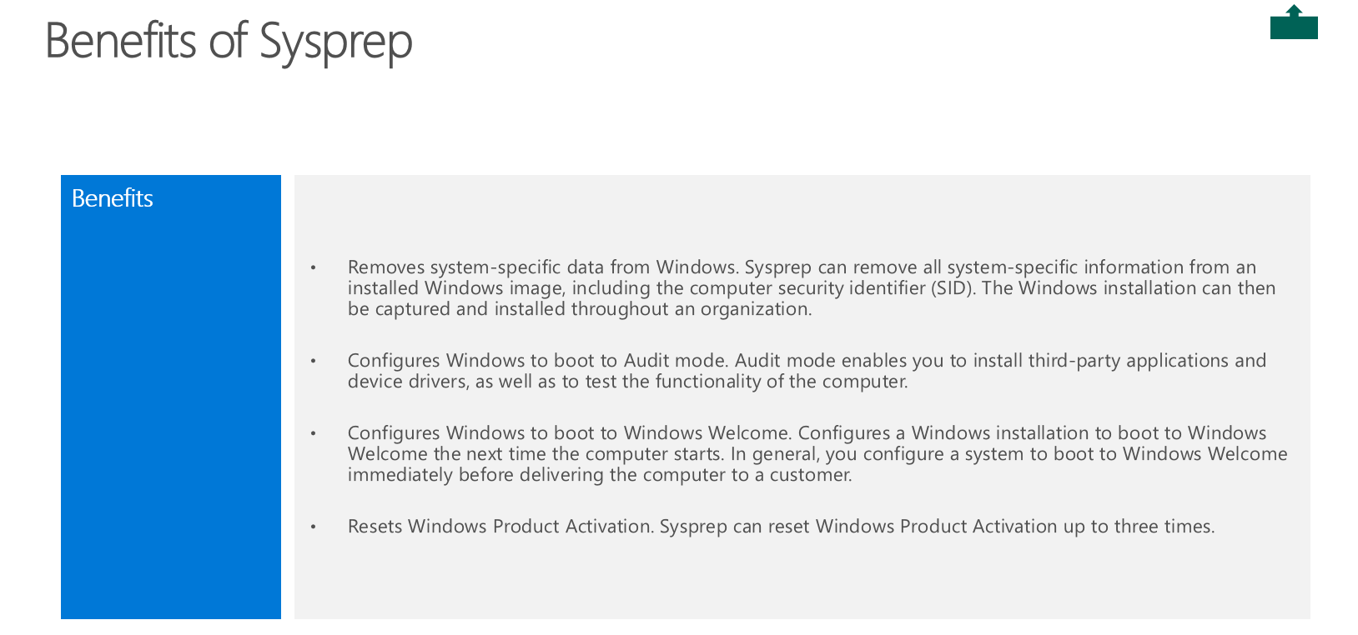

Slide 7
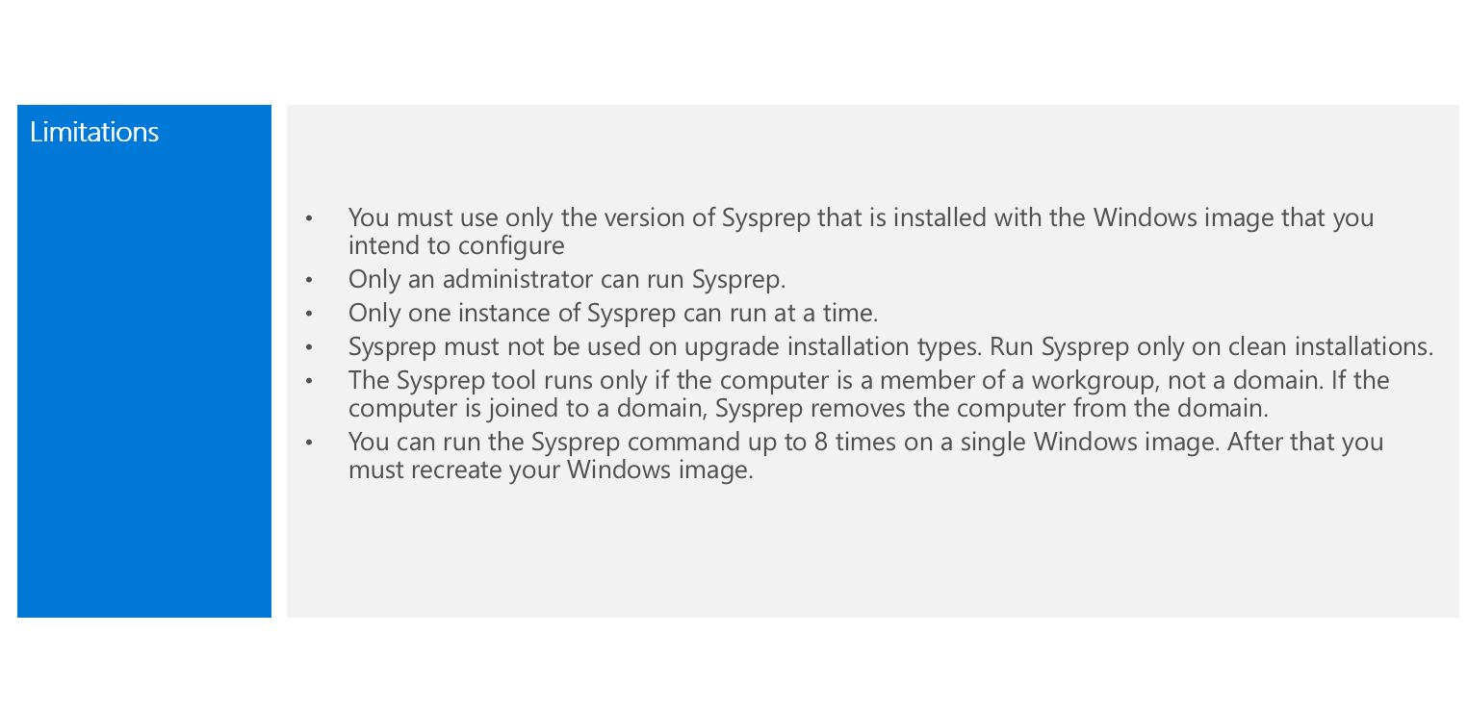
Limitations of Sysprep

Slide 8
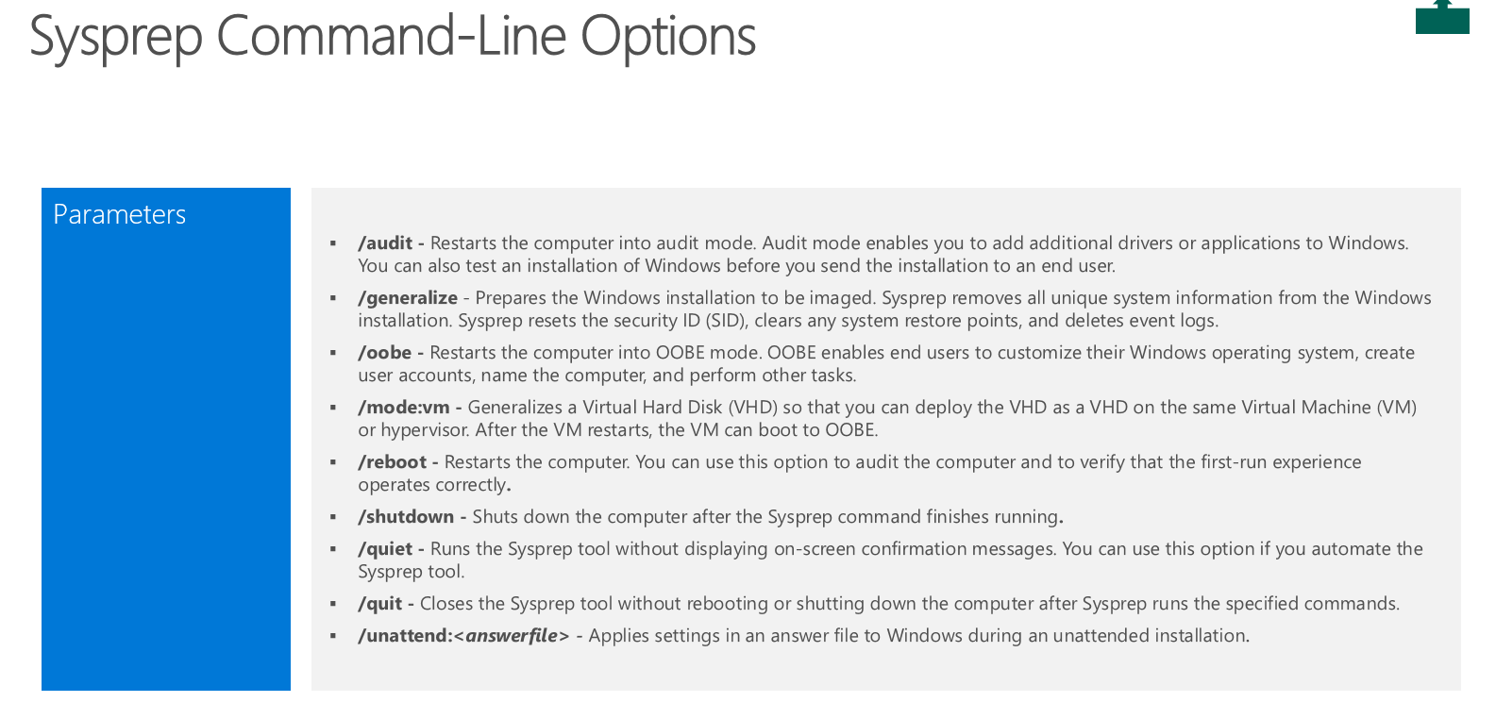
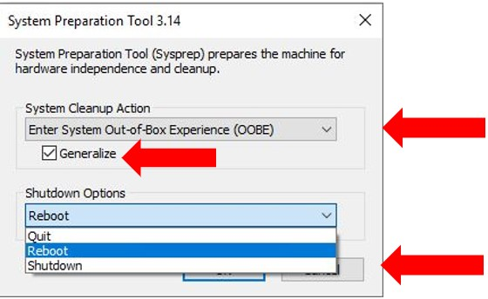

Slide 9
Why Choose VM to capture Image
The reasons for creating the reference image on a virtual platform -
To reduce development time and can use snapshots to test different configurations quickly.
To rule out hardware issues. You simply get the best possible image, and if you have a problem, it's not likely to be hardware related.
To ensures that you won't have unwanted applications that could be installed as part of a driver install but not removed by the Sysprep process.
Building image from a VM also allows you to use Checkpoint/state restores, with checkpoint you can revert back your operating system state to any saved state later which are very useful to run right before you begin the capture process. That is value added feature for experimenting with software or tweaks that may cause problems in operating system.

Slide 10
Deployment Image Servicing and Management (DISM)
It is a command-line tool that is used to mount and service Windows images before deployment. You can use DISM image management commands to mount and get information about Windows image (.wim) files or virtual hard disks (VHD).
You can also use DISM to capture, split, and otherwise manage .wim files.
You can use DISM to install, uninstall, configure, and update Windows features, packages, drivers, and international settings in a .wim file or VHD using the DISM servicing commands.
DISM is installed with Windows, and it is also distributed in the Windows Assessment and Deployment Kit (Windows ADK). DISM replaces several deployment tools, including PEimg, Intlcfg, Image, and Package Manager.

Slide 11
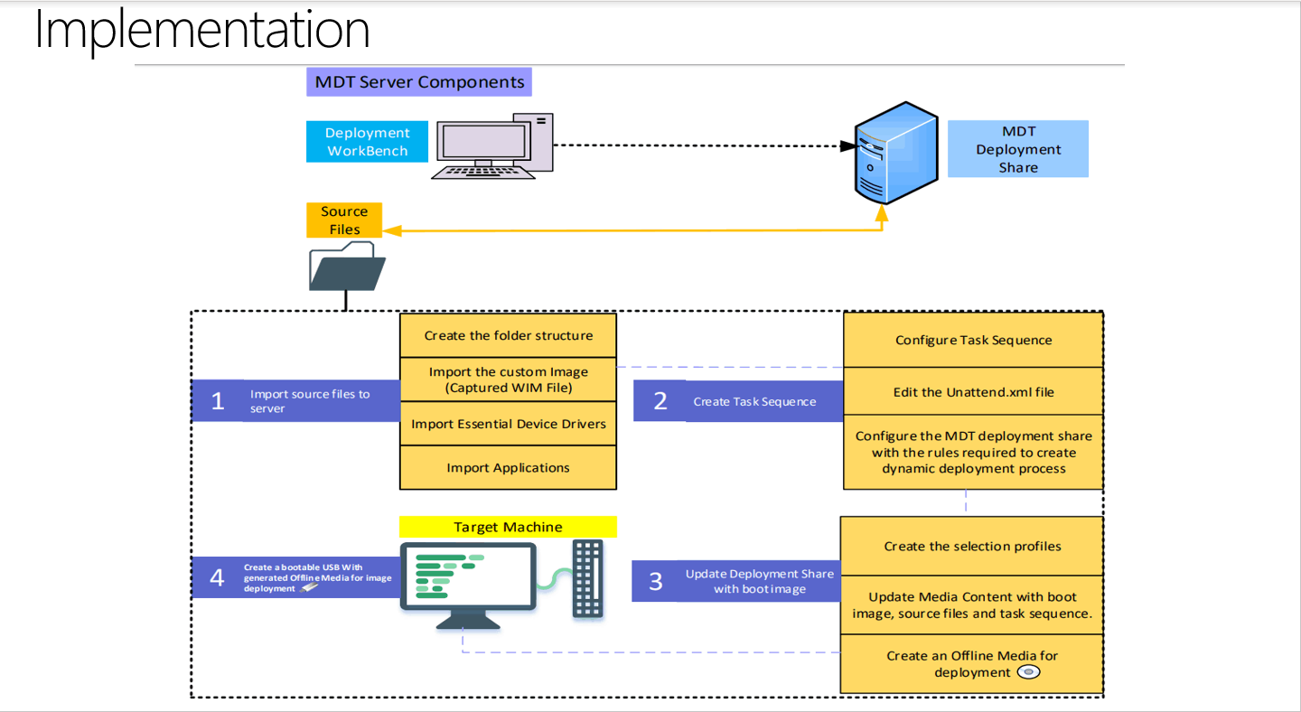

Slide 12


